Slide 1
Wi-Fi Enabled SMART DUSTBIN
An IOT based Smart Dustbin and A Waste Management System

Slide 2
TEAM
1
2
3
Members
Shweta Patil
Raj Kansal
Nihal kale
Rajat Vardam

Slide 3
CHALLENGE
Traditional way
Irregular Management

Slide 4
RESEARCH & DATA
Idea of the smart waste
The system
Smart solution

Slide 5
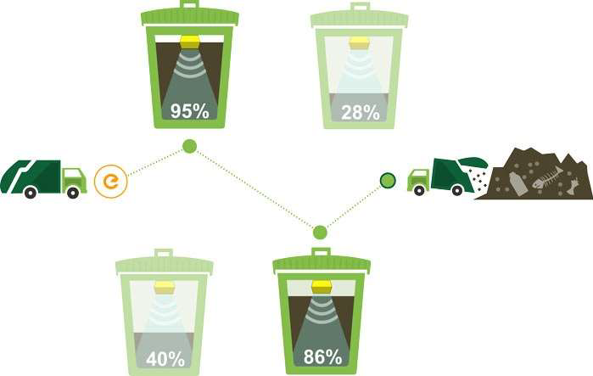
IDEA
The motive of using this method of disposal is the waste will be disposed in the bin and emptying the bin is easy.
In this method a container storage bin will be present for disposal of waste.
Traditional Bin- If the bin is not emptied immediately after it gets full then various flies, mosquitoes and other insects will be around it which leads to a cause of various diseases.

Slide 6
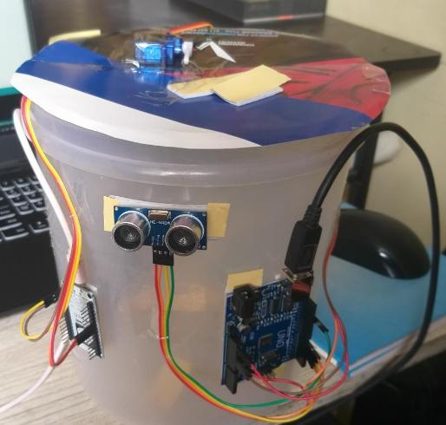
IMPLEMENTATION
System Consists of a sensor in order to detect human hand signal
The dustbin opens automatically when it receives the signal.
We used IFTTT to develop the online web part for the iot system.

Slide 7
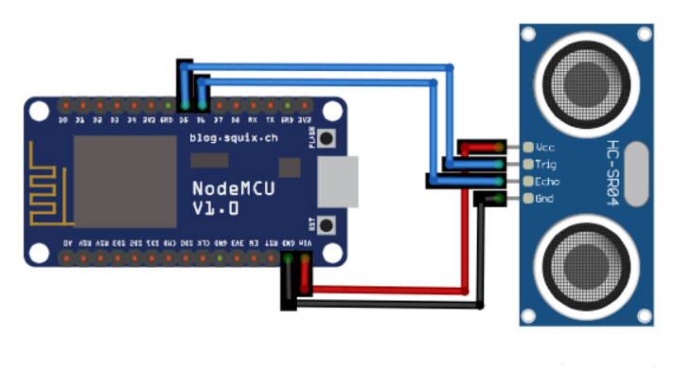
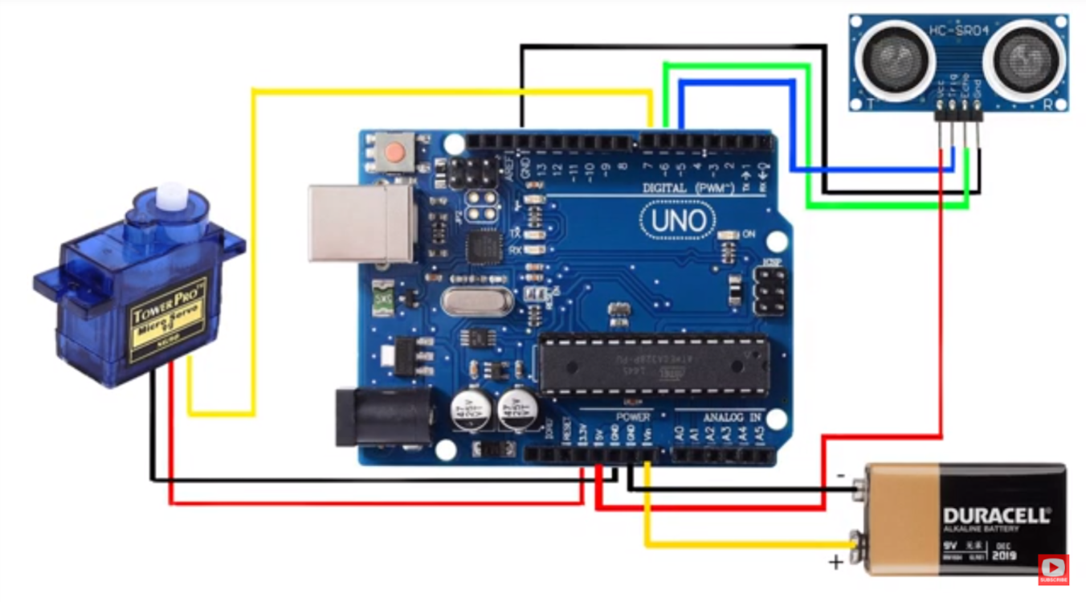
Circuit diagram of NodeMCU ESP8266 and Ultrasonic Sensor, which detects the level of trash in the dustbin, which then sends the signal to wifi connected web server to show its level and as soon as the level reaches > 70% it notifies us through our Email using IFTTT service.
Circuit diagram showing Arduino and Servo Motor which opens the lid of the dustbin automatically.

Slide 8
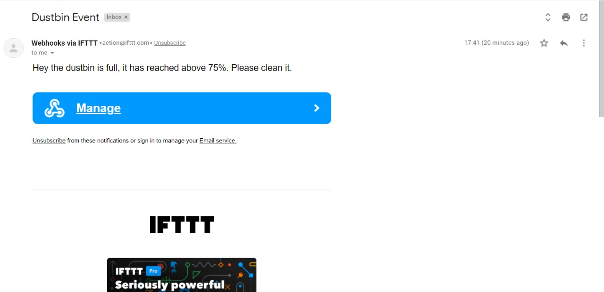
RESULTS

Slide 9
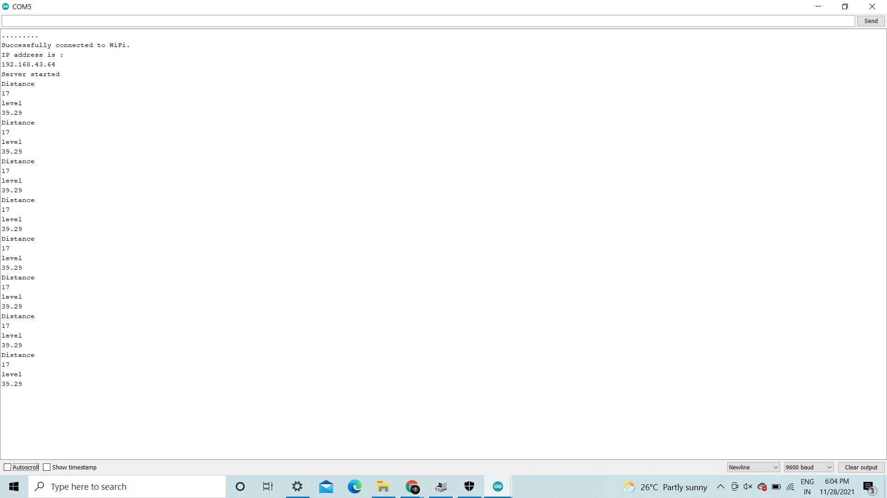


Slide 10
FUTURE SCOPE
The above method is just a stepping stone for implantation of IOT.
There can be many enhancements done for this prototype which can be a revolutionary change in maintaining our environment clean and healthy.
The few enhancements that can be done are:
The implementation of more collective bins placed side by side where it automatically detects the type and waste and places in the correct bin color which is assigned for that type.
These dustbins can be placed with a GPS tracker where the dustbins in a particular locality can be located easily and the waste can be emptied.
This method can lead to a Smart Waste Monitoring System.

Slide 11
THANK
YOU..

